Slide 1
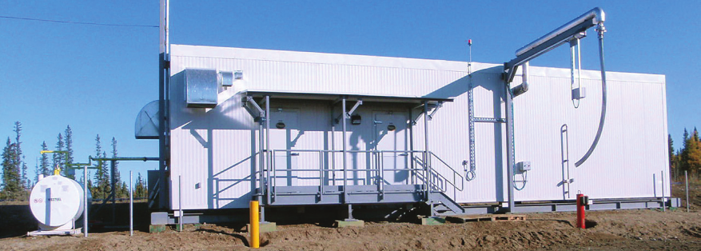
ONEC’s Water Treatment System

Slide 2
Expandable Designs

Slide 3
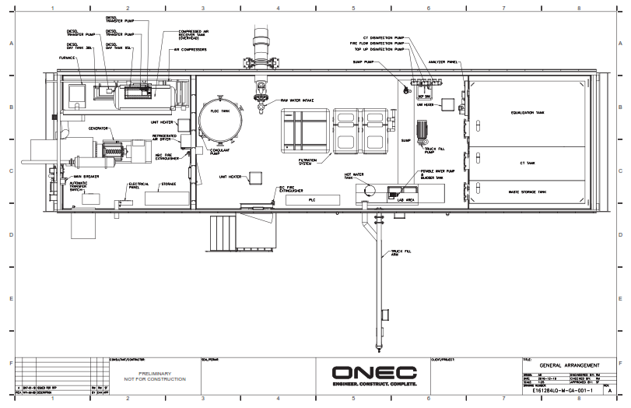

Slide 4
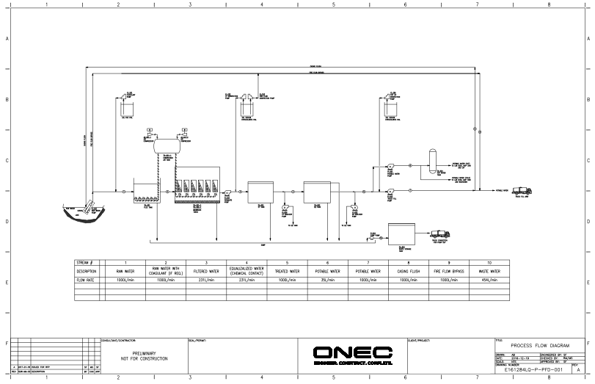

Slide 5
First Step - Water Characterization
Each water treatment plant has a standard layout, but the process is tailored to each communities source water.
Design is based on multi-season water samples to fully characterize and understand raw water quality.
Treatment of surface and ground water sources.

Slide 6
Technology Selection
Notes:
Breadth of knowledge of ONEC to apply appropriate technology to each community.

Slide 7
Project Execution Highlights
Schedule (from design to construction to commissioning)
Design & construction durations less < 6 months
Small footprint (4.9m x 18.3m)
Low power consumption (< 25 kW)
Adaptable to community distribution, firewater and truck-fill systems
Minimal rejected-water stream (< 5%)
Redundant power backup and solar capability

Slide 8
Remote Monitoring
Working with AUG Signals of the Safe Water Project for instrumentation.
Hard wired, LTE/4G/3G cellular connection or satellite for live remote monitoring.

Slide 9
Advantages
Pre-Engineered and flexible design criteria
Cost efficient factory-built designs (> 50% TIC reductions)
ISO 9002 Quality Assurance standards
Minimal infrastructure pre-investment, ‘plug & play’ increased capacity as community grows
Movable to adapt to expanding infrastructure needs
Ease of use, requiring simplified operator training
Reduced schedule from typical project delivery model
Community trades capacity building

Slide 10
Community Engagement & Education
Community collaboration with reputable design, fabrication and training partners
First Nation capacity building in engineering and fabrication partners
Training partners with years of First Nation training experience.

Slide 11
Thank You
Questions?

